Slide 1



Stock Market Analysis
View in Power BI
Last data refresh:
6/3/2022 12:47:38 PM UTC
Downloaded at:
6/3/2022 12:50:00 PM UTC

Slide 2
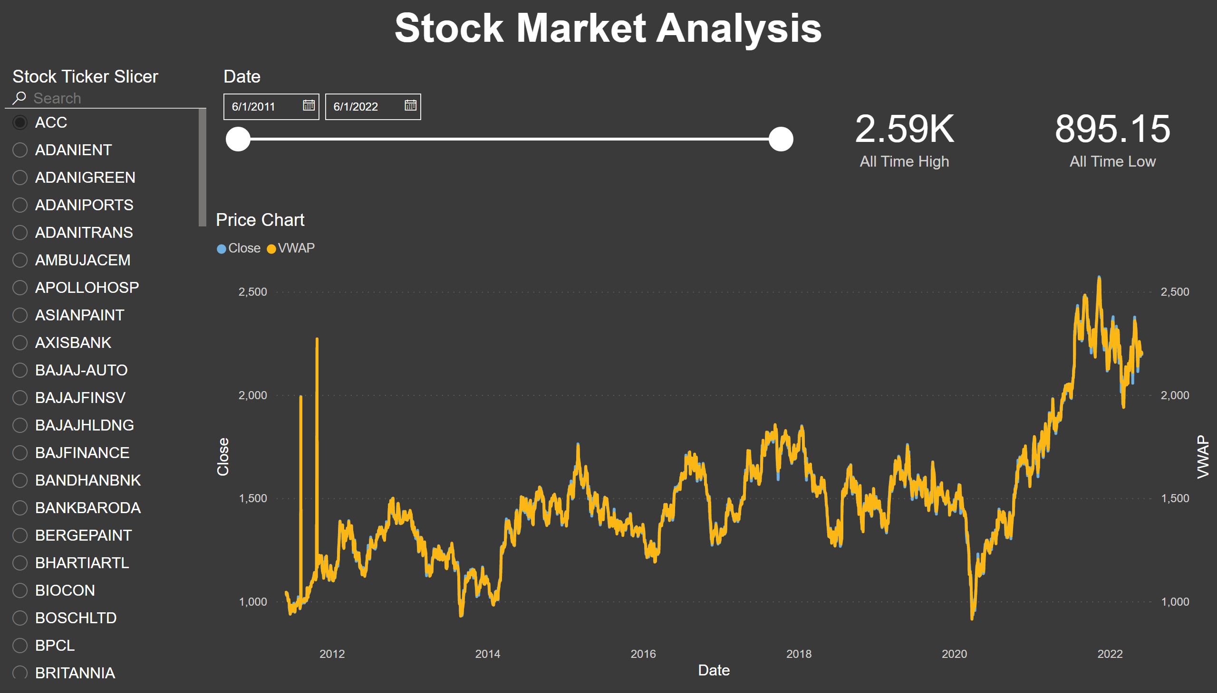
Part 1
Notes:
Price Chart
No alt text provided
slicer
No alt text provided
slicer
No alt text provided
textbox
No alt text provided
card
No alt text provided
card
No alt text provided

Slide 3
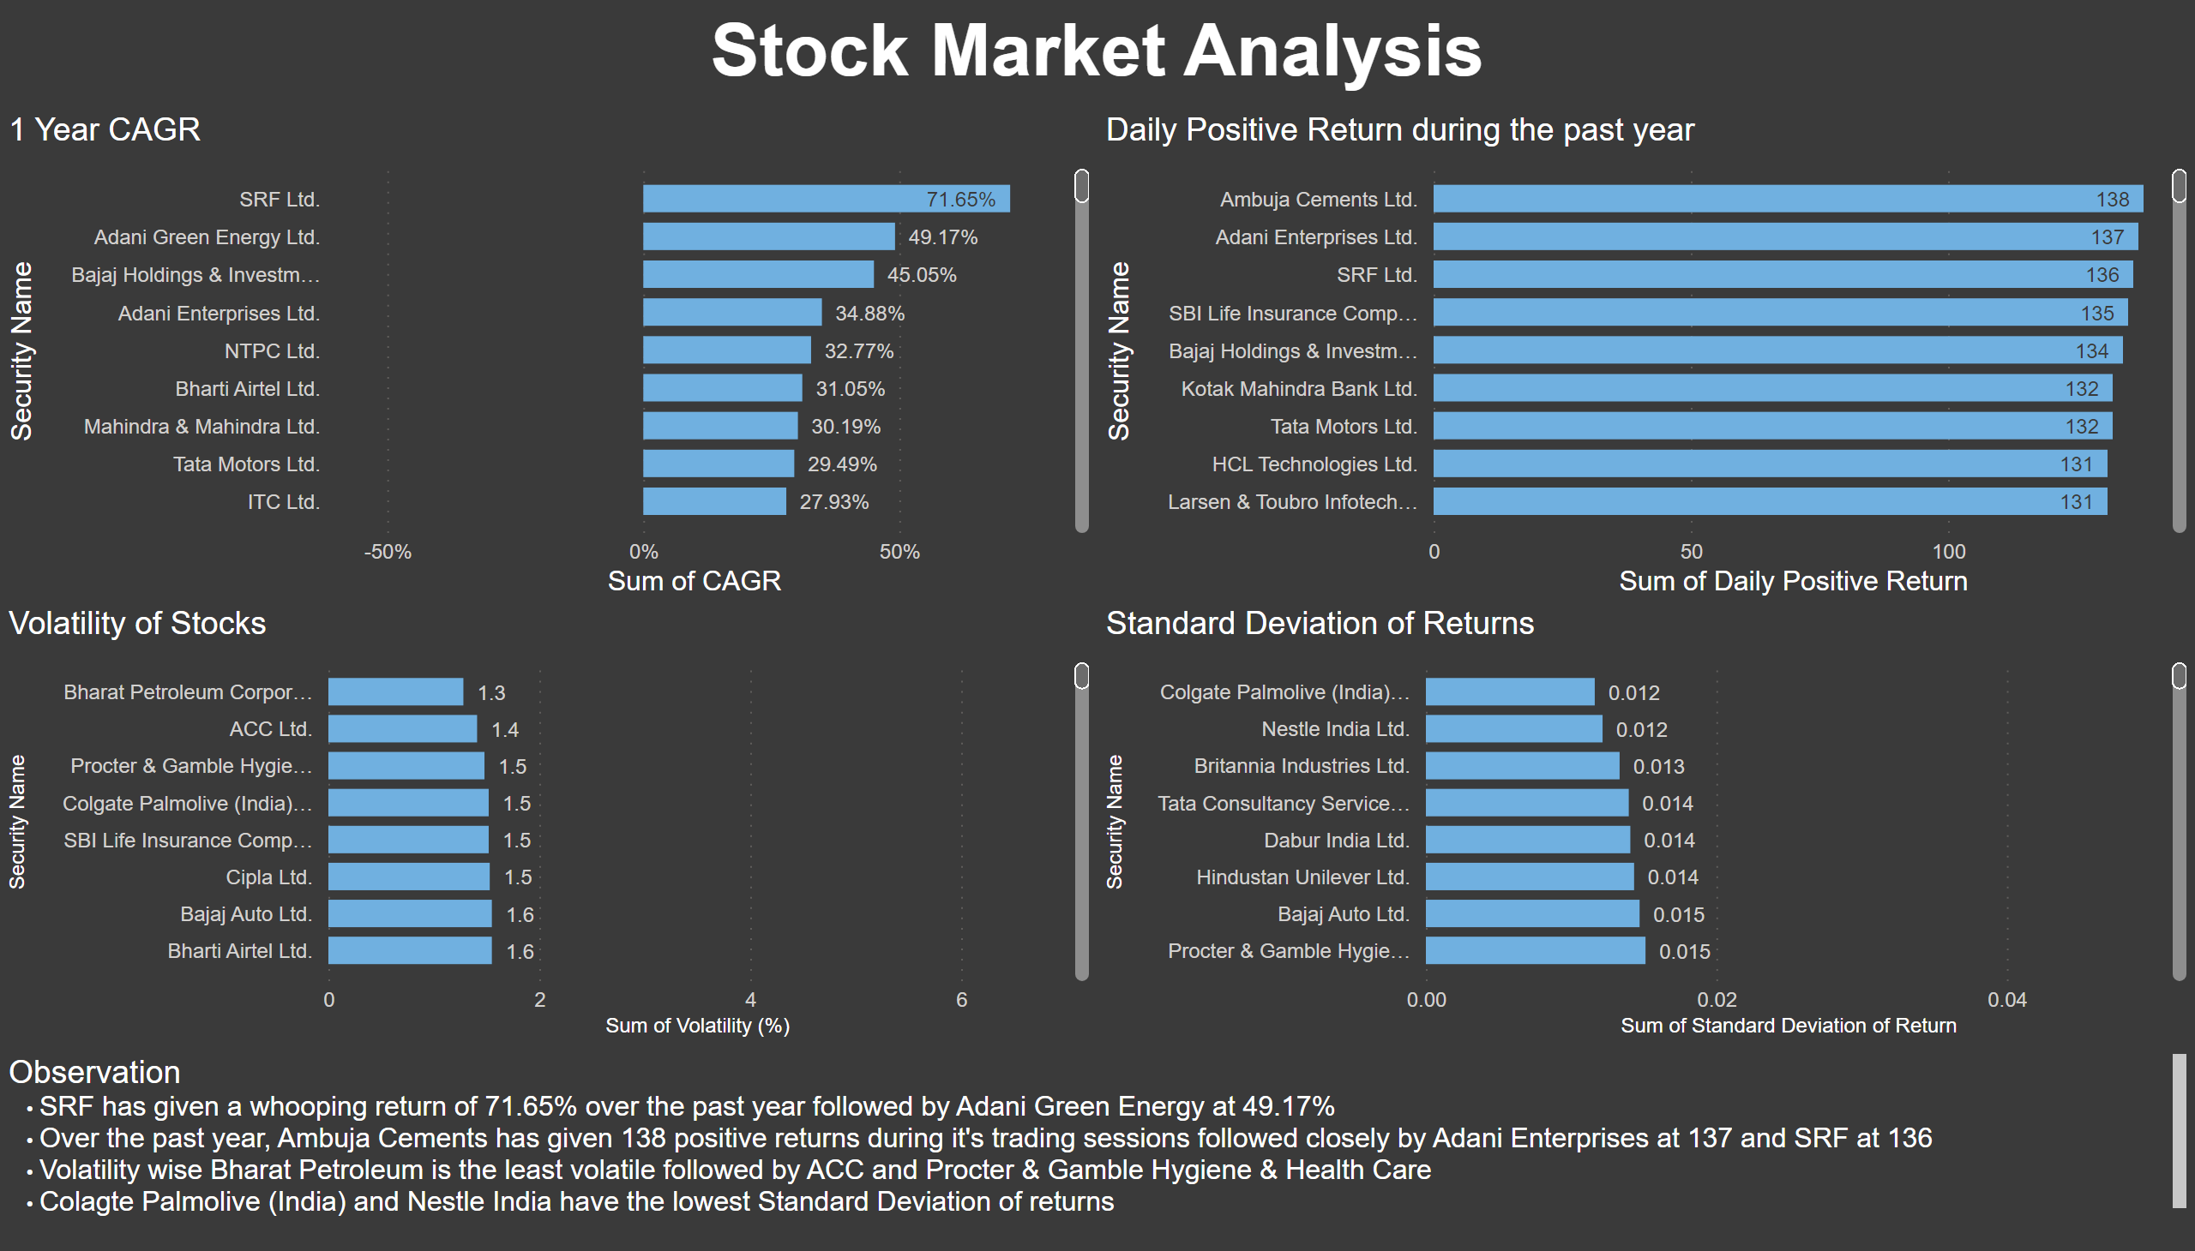
Part 2
Notes:
1 Year CAGR
No alt text provided
Daily Positive Return during the past year
No alt text provided
textbox
No alt text provided
Volatility of Stocks
No alt text provided
textbox
No alt text provided
Standard Deviation of Returns
No alt text provided

Slide 4
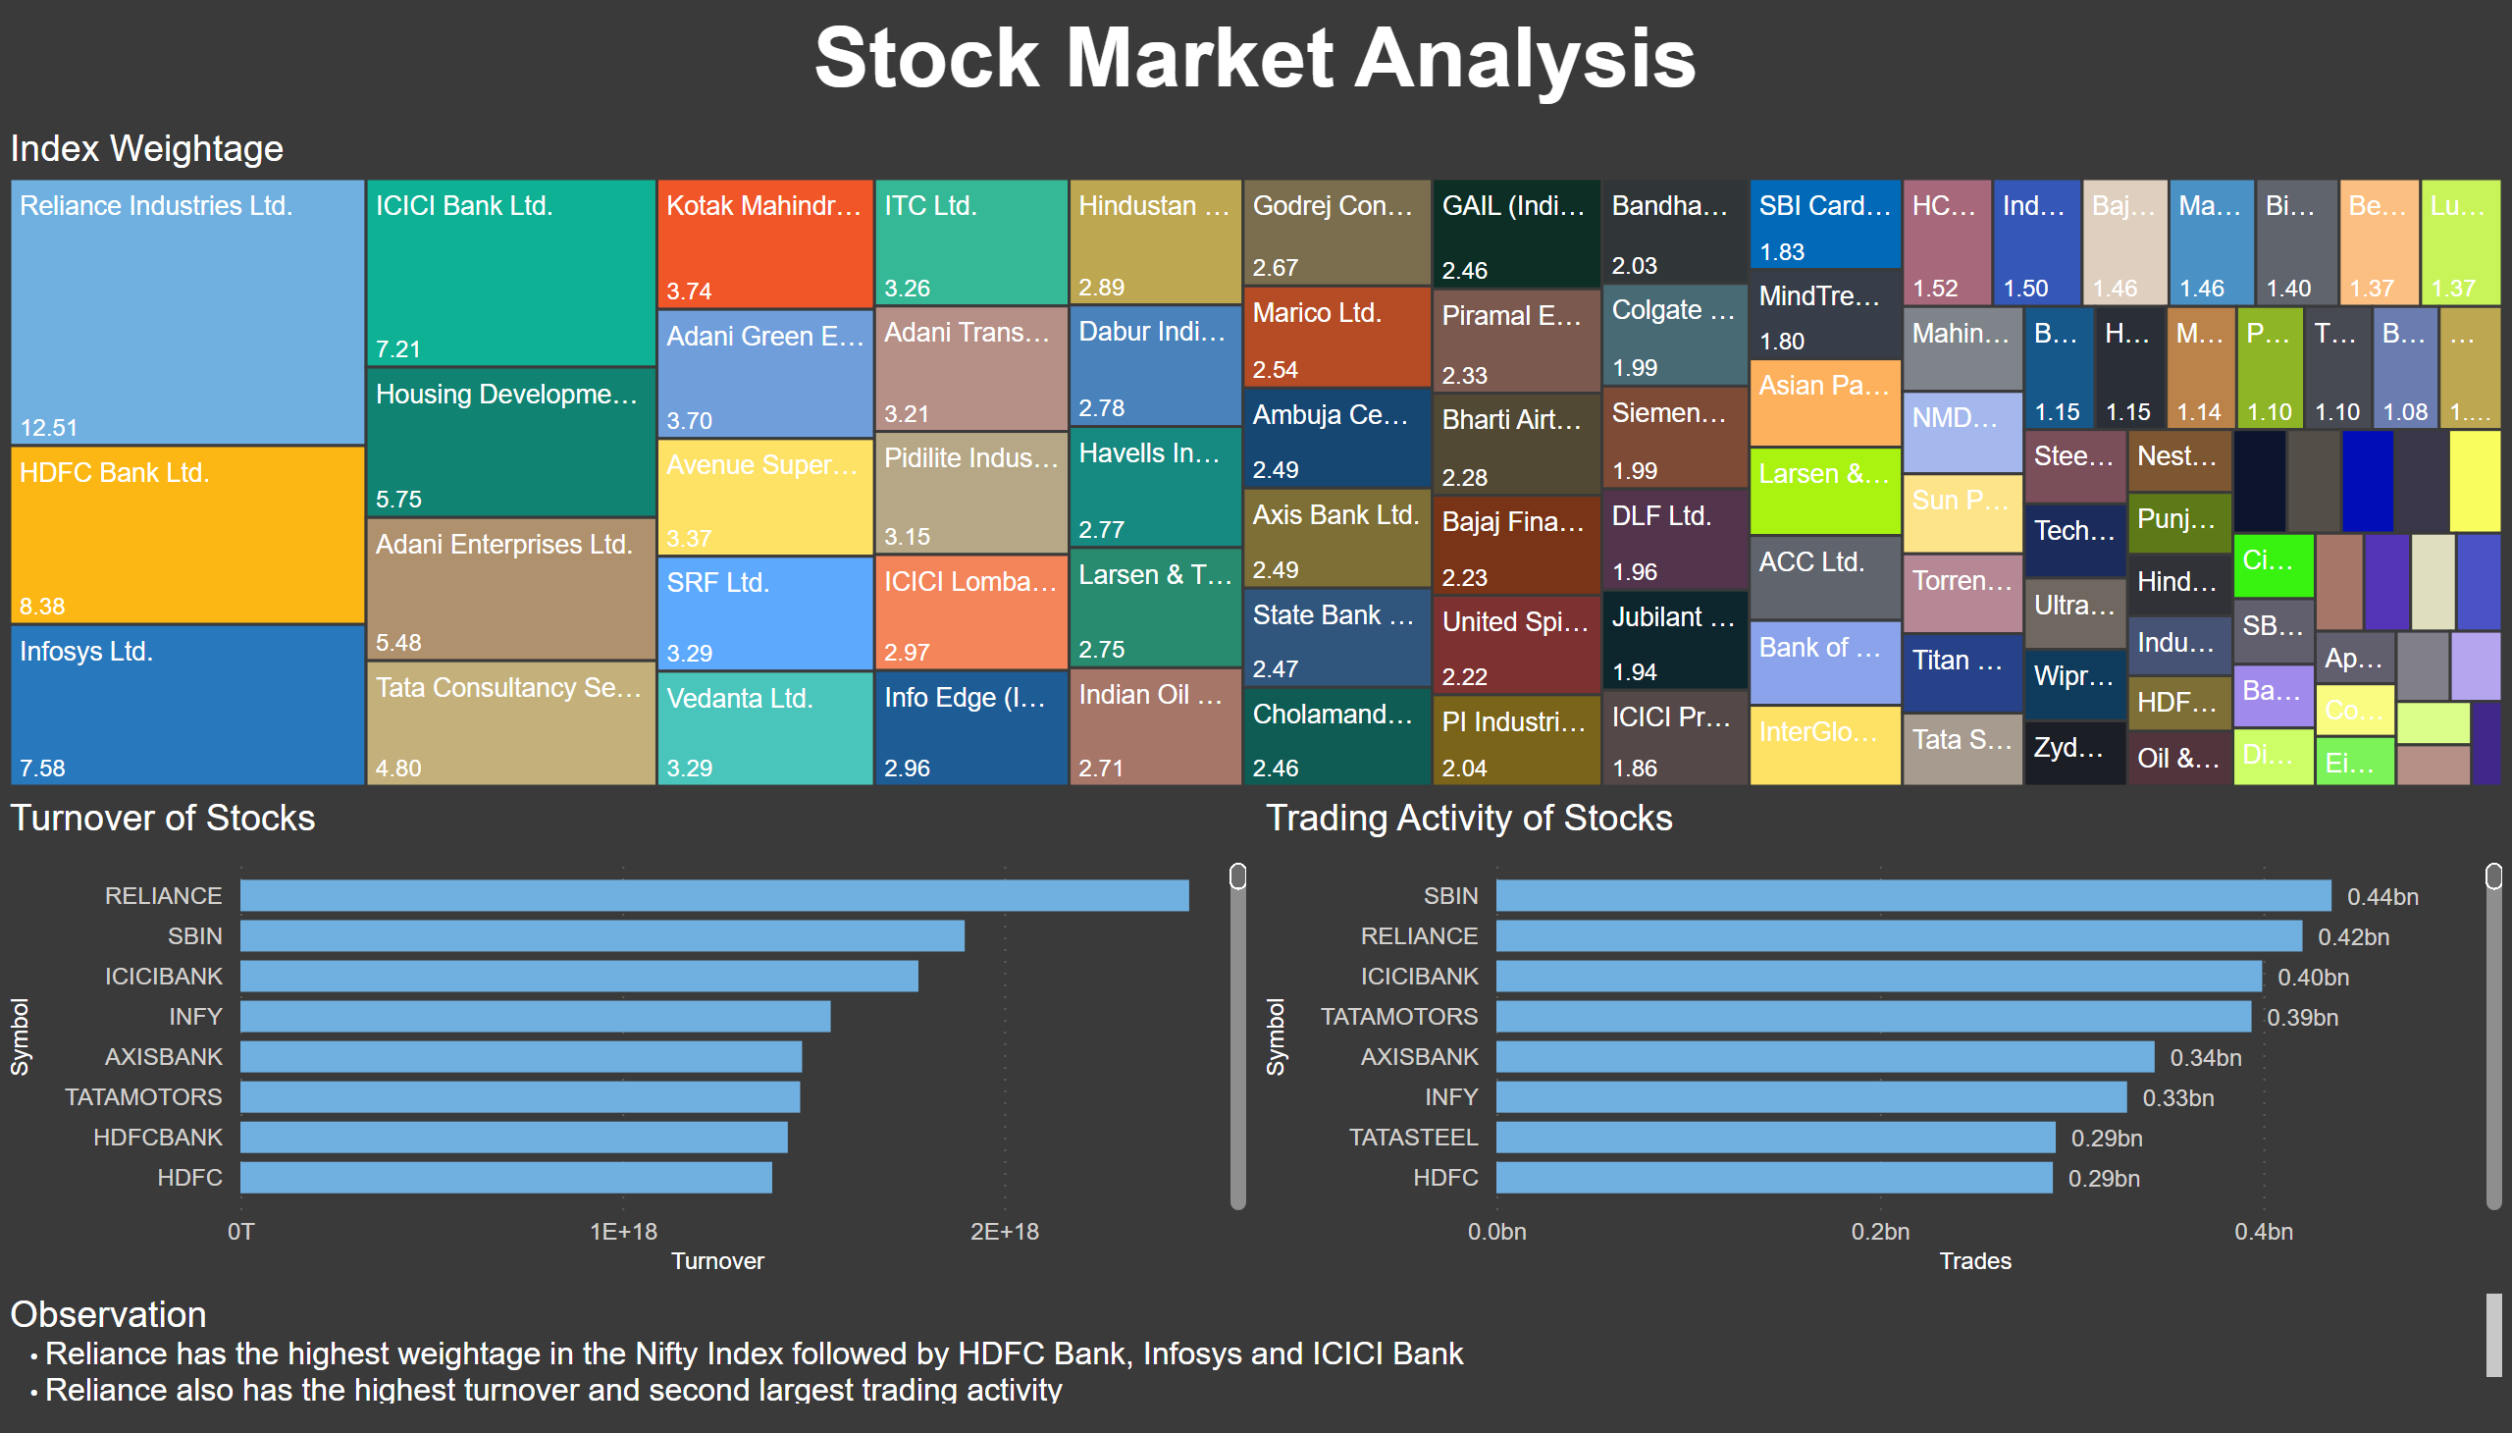
Part 3
Notes:
Index Weightage
No alt text provided
textbox
No alt text provided
Turnover of Stocks
No alt text provided
Trading Activity of Stocks
No alt text provided
textbox
No alt text provided

Slide 5
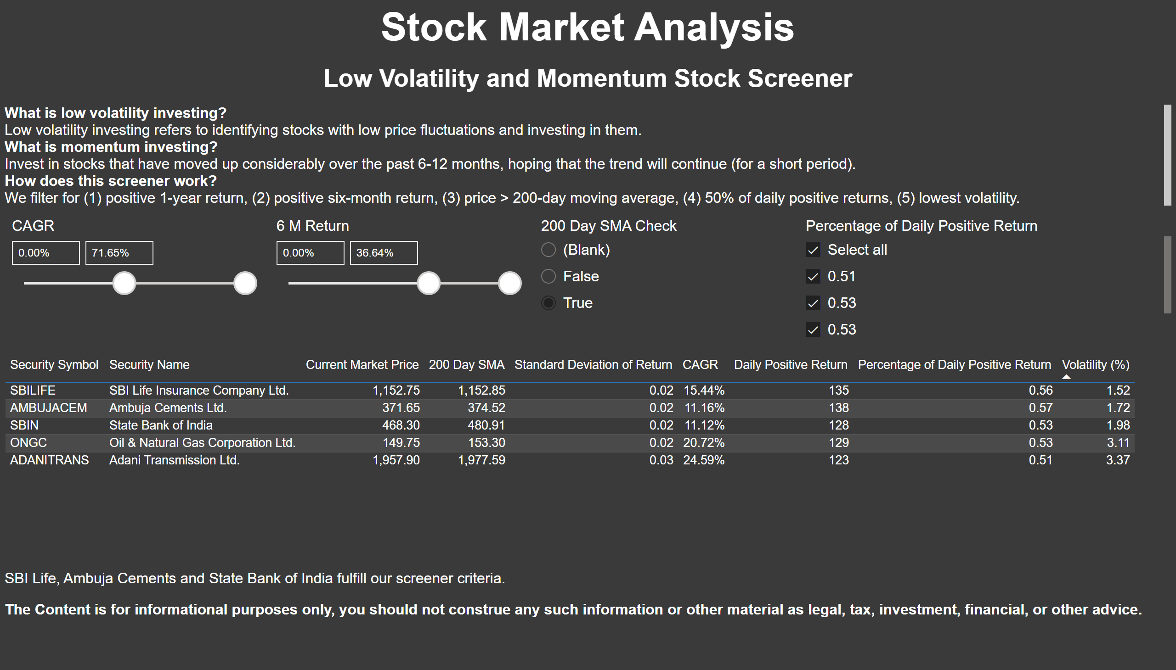
Part 4
Notes:
textbox
No alt text provided
textbox
No alt text provided
tableEx
No alt text provided
slicer
No alt text provided
textbox
No alt text provided
slicer
No alt text provided
slicer
No alt text provided
slicer
No alt text provided
textbox
No alt text provided

